Slide 1

AuE-8230 Autonomy: Science and Systems
Capstone Project
Group 1: Chinmay Samak, Tanmay Samak
Codebase

Slide 2
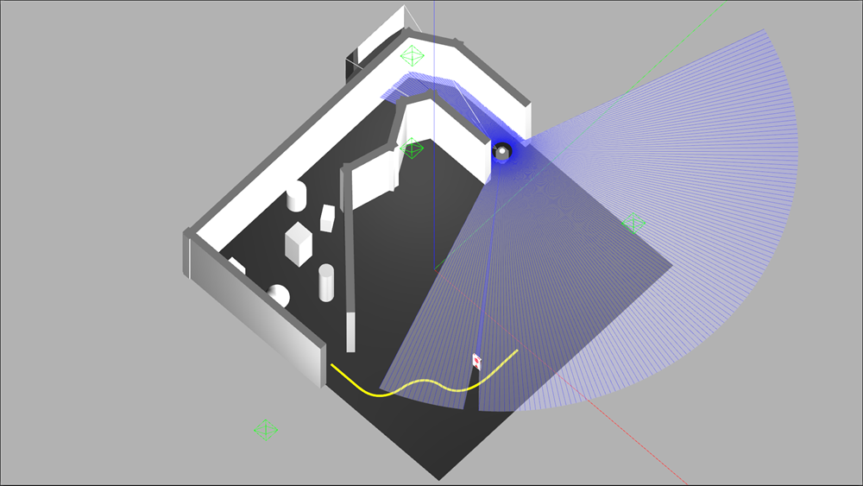
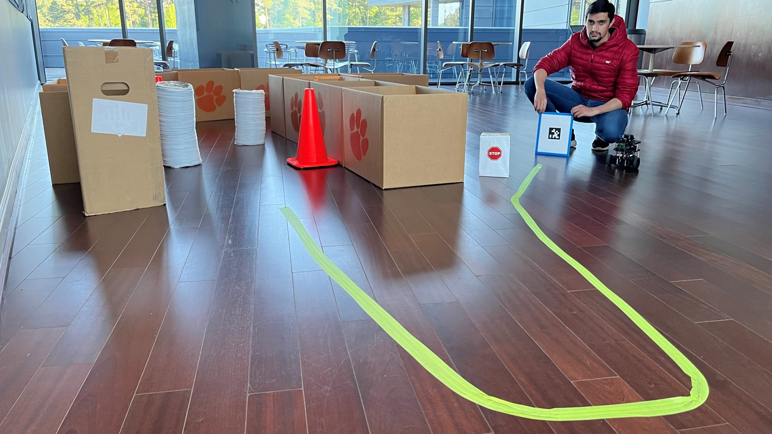
Integration
Finite State Automaton

Slide 3
Approach
START
Initialize
No
Sensors: Camera + LIDAR
Priority:
Priority 1: Stop Sign Detection
Priority 2: Line Following
Priority 3: AprilTag Tracking
Priority 4: Obstacle Avoidance
Priority 5: Wall Following
Alternate approaches:
Keyboard switching
Fiducial markers
No
Yes
Camera Data Available?
Yes
LIDAR Data Available?
Stop Sign Detection
Stop Sign Detected?
Yes
Stop Sign Timer Elapsed?
No
Line
Following
No
Yes
Yes
No
Line Detected?
Yes
Front/Rear Laser Range > 1?
Yes
Left/Right Laser Range > 1?
No
No
AprilTag Detected?
Yes
AprilTag Tracking
Obstacle Avoidance
No
No
Laser Scan LOSM/ROSM < 0.8?
Yes
Left & Right
Laser Range > 1?
Yes
Wall Following
No

Slide 4
Approach
START
Initialize
No
Initialize and check if LIDAR and camera data is available
Priority 1: Stop Sign Detection
True if stop sign detected and timer not elapsed
Priority 2: Line Following
True if line detected, not stopped at stop sign and front/rear and
left/right laser range > 1 m
Priority 3: AprilTag Tracking
True if tag detected, line not detected and not stopped at stop sign
Priority 4: Obstacle Avoidance
True if tag not detected, line not detected, not stopped at stop sign
and laser scan LOSM or ROSM < 0.8
Priority 5: Wall Following
True if tag not detected, line not detected, not stopped at stop sign
and laser scan LSOM or ROSM >= 0.8 or left and right laser range > 1 m
No
Yes
Camera Data Available?
Yes
LIDAR Data Available?
Stop Sign Detection
Stop Sign Detected?
Yes
Stop Sign Timer Elapsed?
No
Line
Following
No
Yes
Yes
No
Line Detected?
Yes
Front/Rear Laser Range > 1?
Yes
Left/Right Laser Range > 1?
No
No
AprilTag Detected?
Yes
AprilTag Tracking
Obstacle Avoidance
No
No
Laser Scan LOSM/ROSM < 0.8?
Yes
Left & Right
Laser Range > 1?
Yes
Wall Following
No

Slide 5
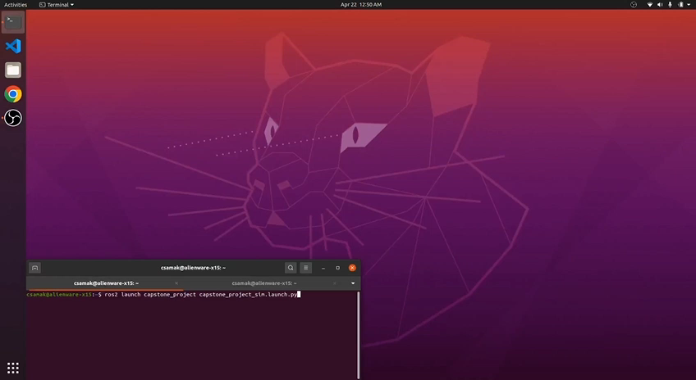
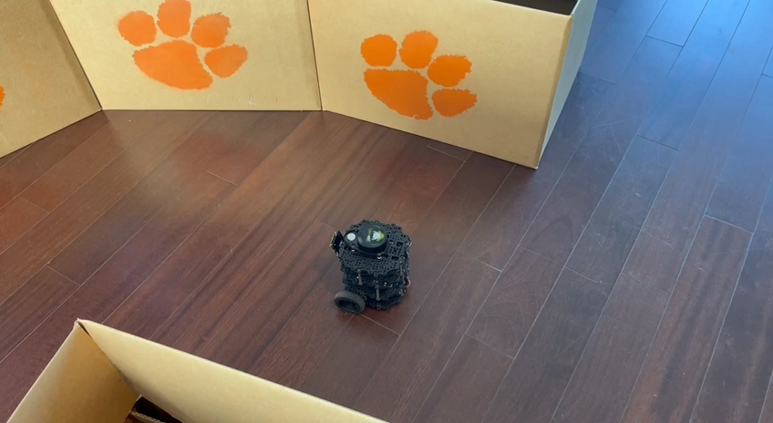
Results
Simulation
Reality

Slide 6
Thank you!
…open to questions and suggestions

